Slide 1
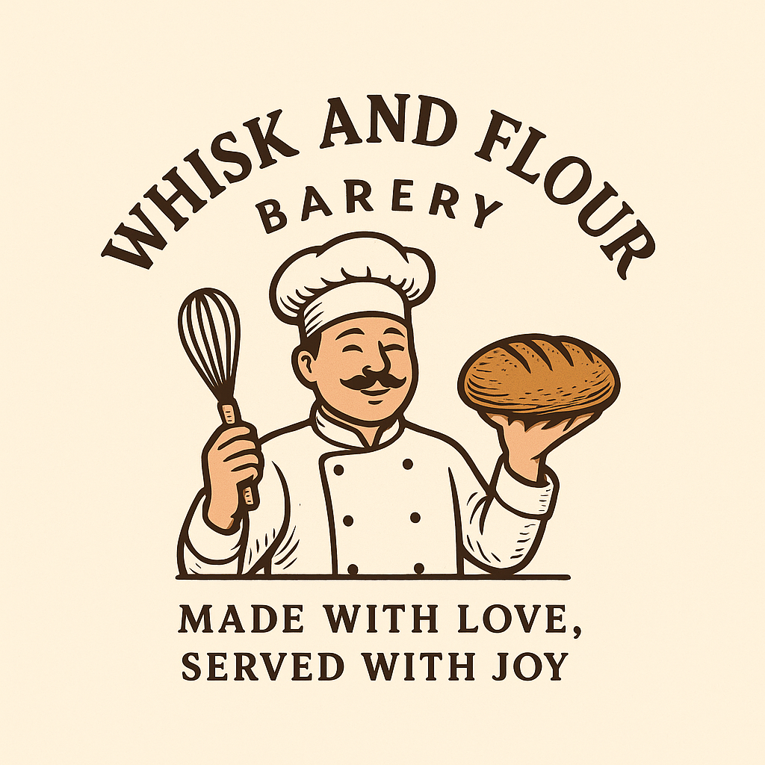
WHISK_AND_FLOUR BAKERY
MADE WITH LOVE, SERVED WITH JOY

Slide 2

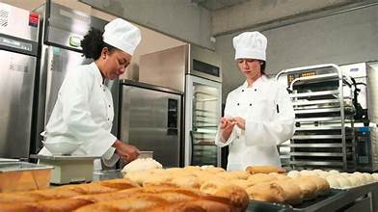
AI Solution
Whisk & Flour AI Demand Forecasting and Recommendation System
Transforming bakery operations using Artificial Intelligence
Combines predictive analytics with conversational AI
Enhances efficiency, profitability, and customer experience

Slide 3
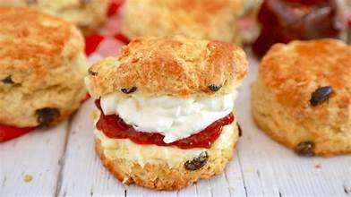
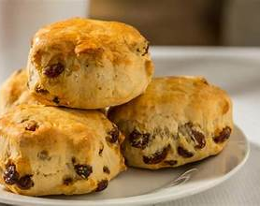
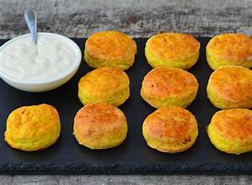
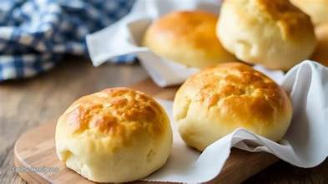
system overview
Key points
Forecasts help optimize inventory, reduce waste, and prevent stockouts.
Features an NLP chatbot that interacts with customers, identifies dietary needs and product interests, and gives personalized recommendations.
Automates demand planning and customer service to boost efficiency, cut costs, and enhance satisfaction through data-driven decisions.

Slide 4
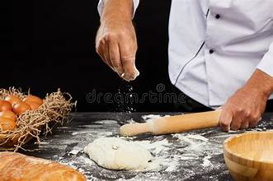
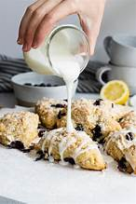

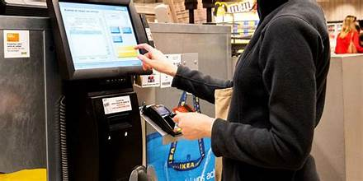
Business Objectives
1. . Improve Operational Efficiency
Accurately forecast demand to prevent over- and underproduction.
Streamline ingredient purchasing and reduce on-hand waste.
2. Enhance Customer Experience
Provide personalized recipe and product recommendations.
Reduce wait times with AI-powered ordering.

Slide 5
Business Objectives (Cont.)
3. Increase Profit
Align production to customer demand to save costs and make more sales.
Drive trending or high-margin products intelligently.
4. Leverage Data for Strategic Decisions
Track sales trends for product innovation, marketing campaigns, and seasonal promotions.

Slide 6
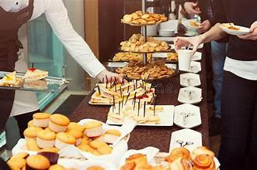
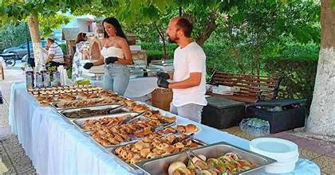
Business Success Criteria
1. Forecasting Accuracy
At least 85% day-to-day and week-to-week forecast accuracy
Perform accurately during holidays and special occasions.
2. Operational Efficiency
Remove at least 30% waste caused by overproduction.
Improve stock availability to 95% on best-selling items.
Decrease manual planning time by 40%.

Slide 7
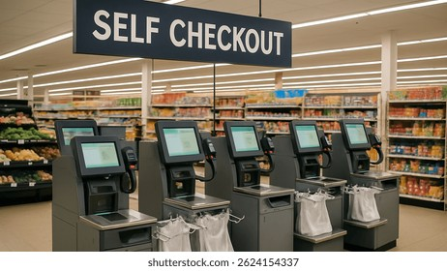
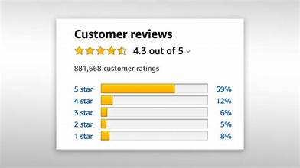
Business SuccessCriteria (cont.)
3. Customer Experience
70% of customers use chatbot within six months.
Maintain minimum 90% satisfaction rating.
Reduce wait time by at least 25%.
4. Financial Performance
Increase overall sales revenue by 15% within the first year.
Achieve positive ROI through reduced waste and increased sales margins

Slide 8
Requirements
Analyze historic sales data to forecast daily and weekly demands.
Provide inventory and manufacturing recommendations.
NLP-based chatbot for orders, suggestions, and dietary choices.
Chatbot classifies preferences and provides menu recommendations.
Dashboard access for staff to track forecasts and analytics.

Slide 9
Non-Functional Requirements & business Background
Forecasting accuracy of at least 85%.
Scalable, user-friendly, and reliable system.
Chatbot response time: 2–3 seconds.
Operational 95% of the time.
Business Background
Whisk & Flour is a growing artisan bakery facing issues of overproduction, waste, stockouts, and lack of personalized service. Project aligns with 4IR through AI adoption in a traditional bakery.

Slide 10
Risk and constraints
Major Risks :
Poor data quality affecting model accuracy
Low user adoption of AI tools
Technical integration and security issues
Project Constraints:
Limited budget and development time
Need for clean, structured historical data
Compliance with POPIA data protection laws

Slide 11
Tools and techniqu es
Core Tools Used
Machine learning: Scikit-learn, statsmodels, facebook prophet
NLP: Text classification and keyword extraction
Data Handling: Pandas,Numpy for data cleaning and analysis
Visualization: Matplotlib for visualizing sales trends and forecast.
Purpose:
Enable data-driven forecasting, visualization, and recommendation

Slide 12
Problem:
Solution:
Inaccurate demand forecasting leading to overproduction or stockouts.
High levels of food waste and lost sales opportunities.
Manual, experience-based production planning instead of data-driven methods.
Limited personalized customer engagement, especially during busy hours.
AI-powered forecasting to predict product demand accurately and optimize stock management.
Chatbot system providing personalized product recommendations and dietary options
Improved efficiency, reduced waste, and enhanced customer satisfaction
Increased sales through smart recommendations and better resource allocation.

Slide 13
Impact of the AI System
Expected outcomes
Accurate, automated demand forecasting
Reduced waste and improved stock control
Faster customer service via chatbot
Personalized product experiences
Data-driven decisions and sustained profitability

